Slide 1
Introduction of MiniNDN-WiFi
Xian GUO
Net Researcher Lab, CS, UoM
9-30-2017

Slide 2
Design Goal
To implement WiFi module in Minindn
Can emulate a wireless network based on WiFi (IEEE 802.11)
Wire
MiniNDN-WiFi
Access Points
Wireless
Stationary
Ad Hoc
Mobility
Fig1. The Structure of MiniNDN-WiFi

Slide 3
Design Route
Import classes from minindn and mininet-wifi
mininnet
minindn
mininet-wifi
MiniNDN-WiFI
Fig2. The Relationship of Moduls

Slide 4
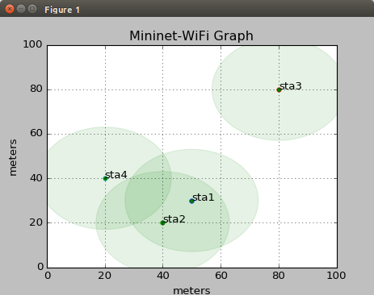
Design Status & Next Works
Can emulate a wireless network with APs
Can emulate an ad hoc network
Need to select or design a routing protocol for MANET
ap1
Ethernet
ap2
sta1
sta2
sta3
sta4
wifi
wifi
Fig3. AP network
Fig4. Ad Hoc network

Slide 5
The Structure of Directories
minindn-wifi
bin
minindn
docs
ndnadhoc.py
ndnwifi
wificonf_parser.py
Wifiutil.py
adhoc-tology.conf
Ndnwifi_utils
topologies
multiap-topology.conf
Singleap-topology.conf
AuTHORS.md
COOPYING.md
Makefile
README.md
Install.sh
Setup.py
Fig5. Directories and Files

Slide 6
Flow of MiniNDN-WiFi
User selects configuration parameters or configuration file for network need to be emulated
Generate topology objects according to User’s selection
Create network objects according to topology objects
  Host, Station, Switch, Link etc.
Start network emulation
Perform network commands in CLI.
Begin
User Parameters
Topology objects
Network objects
Start Network
CLI
end
Fig3. Flow chart

Slide 7
Implement Detail-customize a topology
User uses a template file to customize a network topology
Wrote three default files. These files were put in the folder Topologies.
Link to Template Files
These files will be copied to installation directory
  Default directory:
  /usr/local/etc/mini-ndn/wifi
MiniNDN-WiFi
Ndnwifi_utils
Topologies
Singleap-topolog.conf
multiap-topolog.conf
adhoc-topolog.conf

Slide 8
Implement Detail-parse a template file
To generate topology objects from a template file, copied this file conf_parser.py as wificonf_parser.py.
Added two classes confNdnStation(), confNdnAccessPoint() and two functions parse_stations() and parse_accessPoint() in this wificonf_parser.py.
And this modified file is put in a new directory ‘ndnwifi’.
The two classes and two functions are used to create topology objects according to a configure file of topolgy.
MiniNDN-WiFi
ndnwifi
wificonf_parser.py

Slide 9
Implement Detail-create network objects
Create network objects according topology objects
Use two methods
  Directly use classes and functions in mininet-wifi file net.py. e.g.. function buildFromTopo()
  Wire functions that is similar with buildFromTopo() to customize a network.
  For example, wrote a function in a new file ndnadhoc.py to customize an ad hoc network. This file is putted in folder ndnwifi
MiniNDN-WiFi
ndnwifi
ndnadhoc.py

